Slide 1
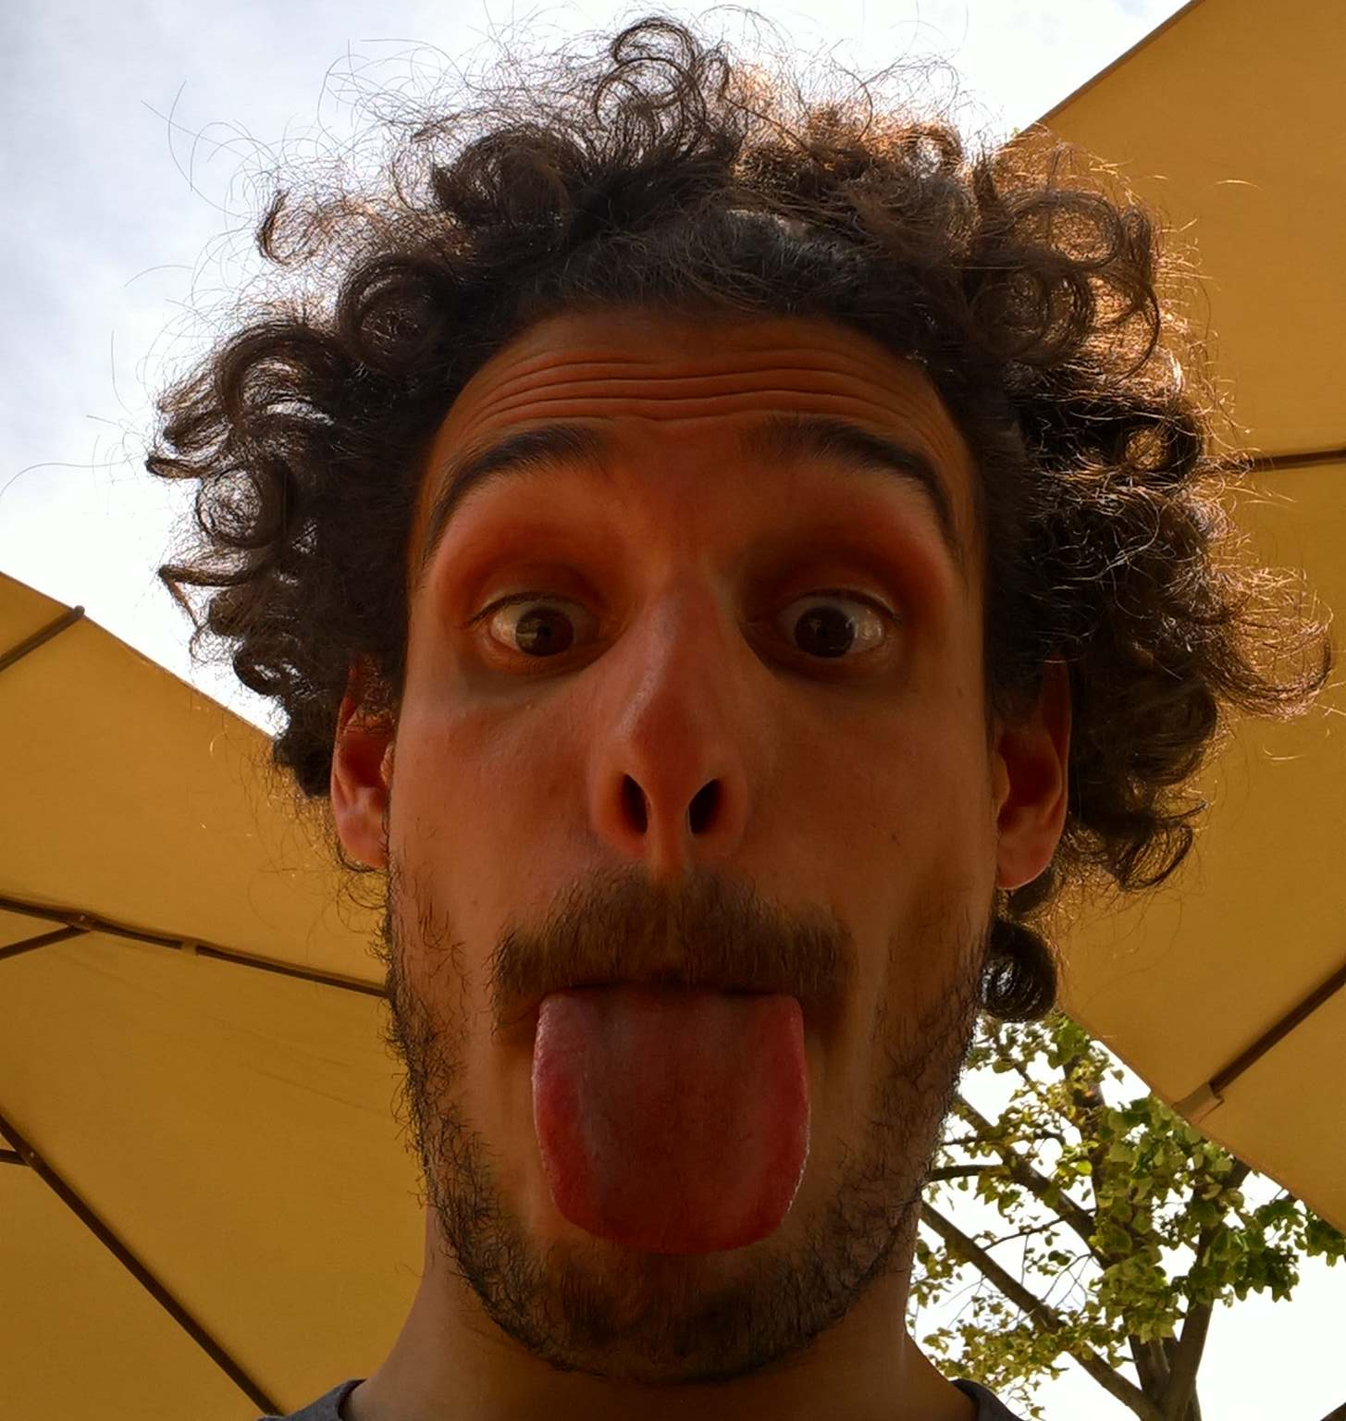

Am I a scientist?
From Greek,
to energy saving,
to photochemistry,
to electrochemistry…
and so on!
(Dr.) Federico Dattila
@FedeDat

Slide 2
Interactive presentation
Feel free to ask while I am presenting!
One volunteer needed!
Whenever you see the Quiz sign, get ready to write in the chat!
Q1

Slide 3
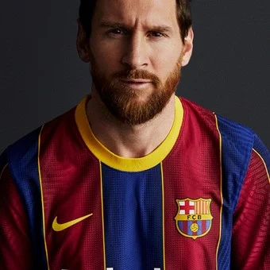

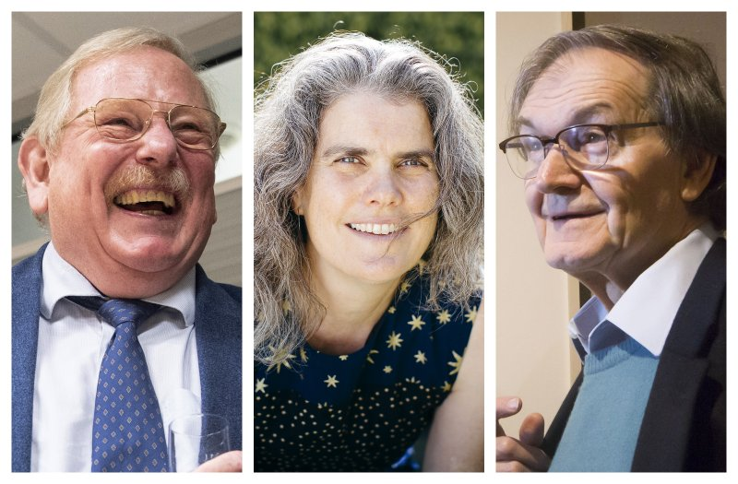
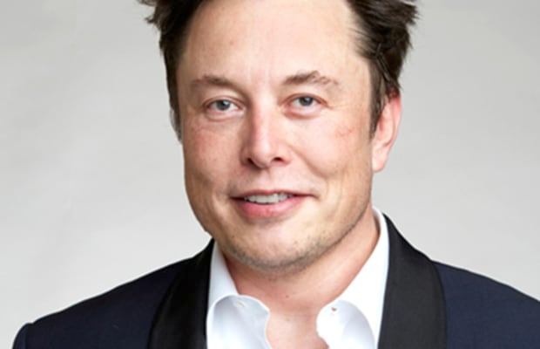
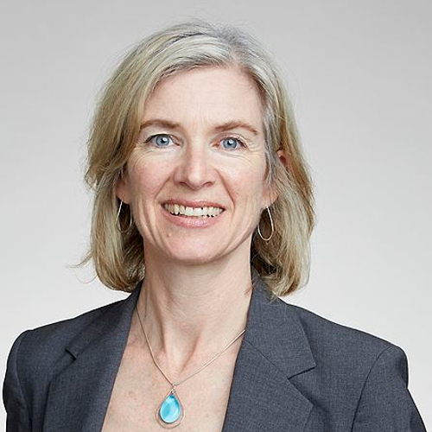
Q1
1
2
Lionel Messi, football player
Chiara Ferragni, influencer, entrepreneur
3
4
5
Roger Penrose, Nobel 2020
Elon Musk, entrepreneur
Jennifer Doudna, Nobel 2020

Slide 4
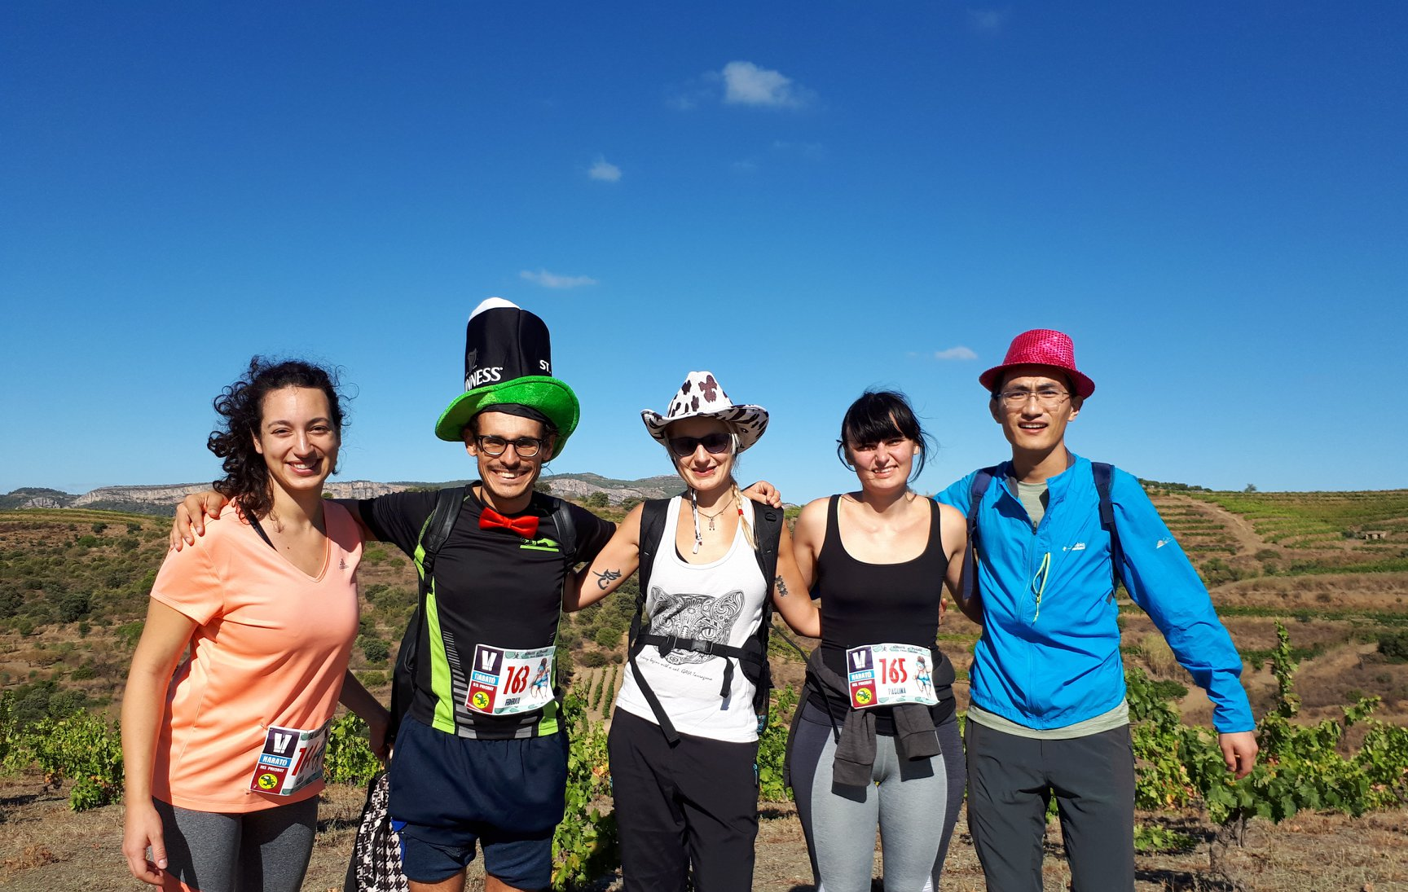
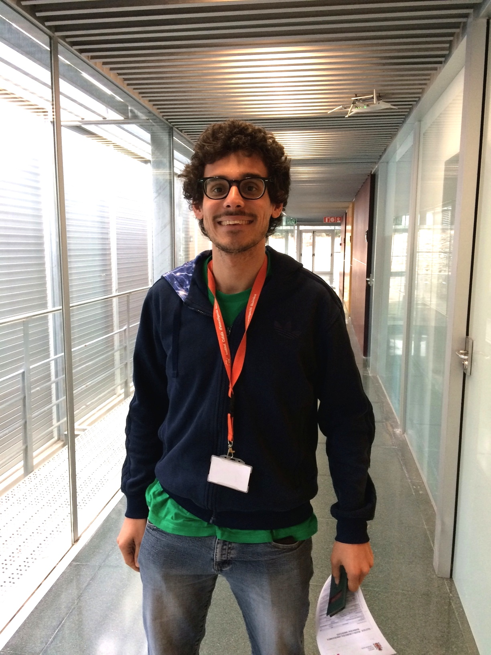
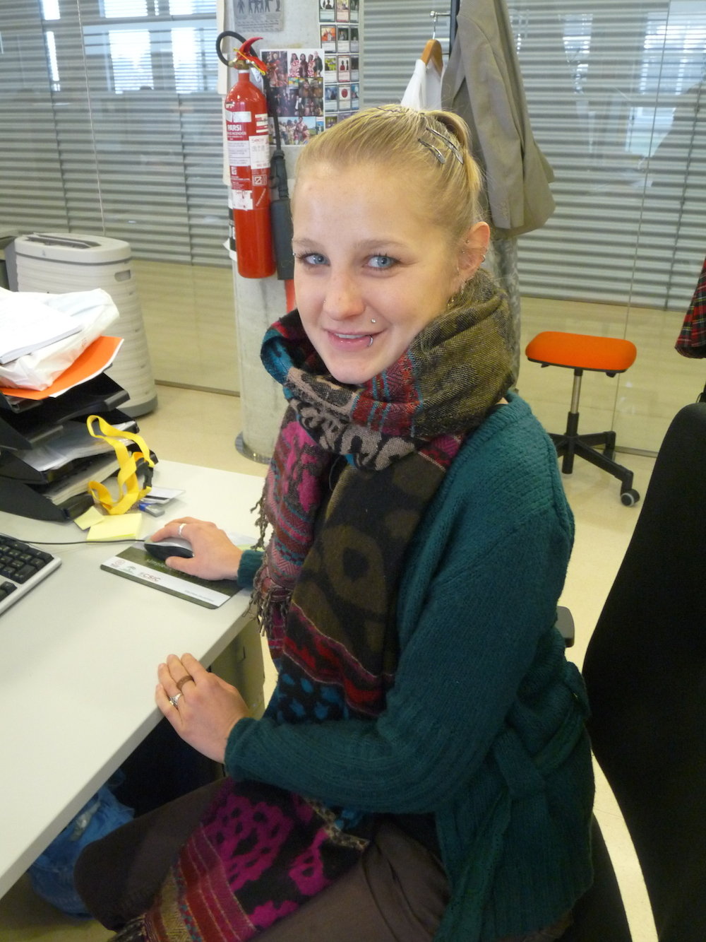
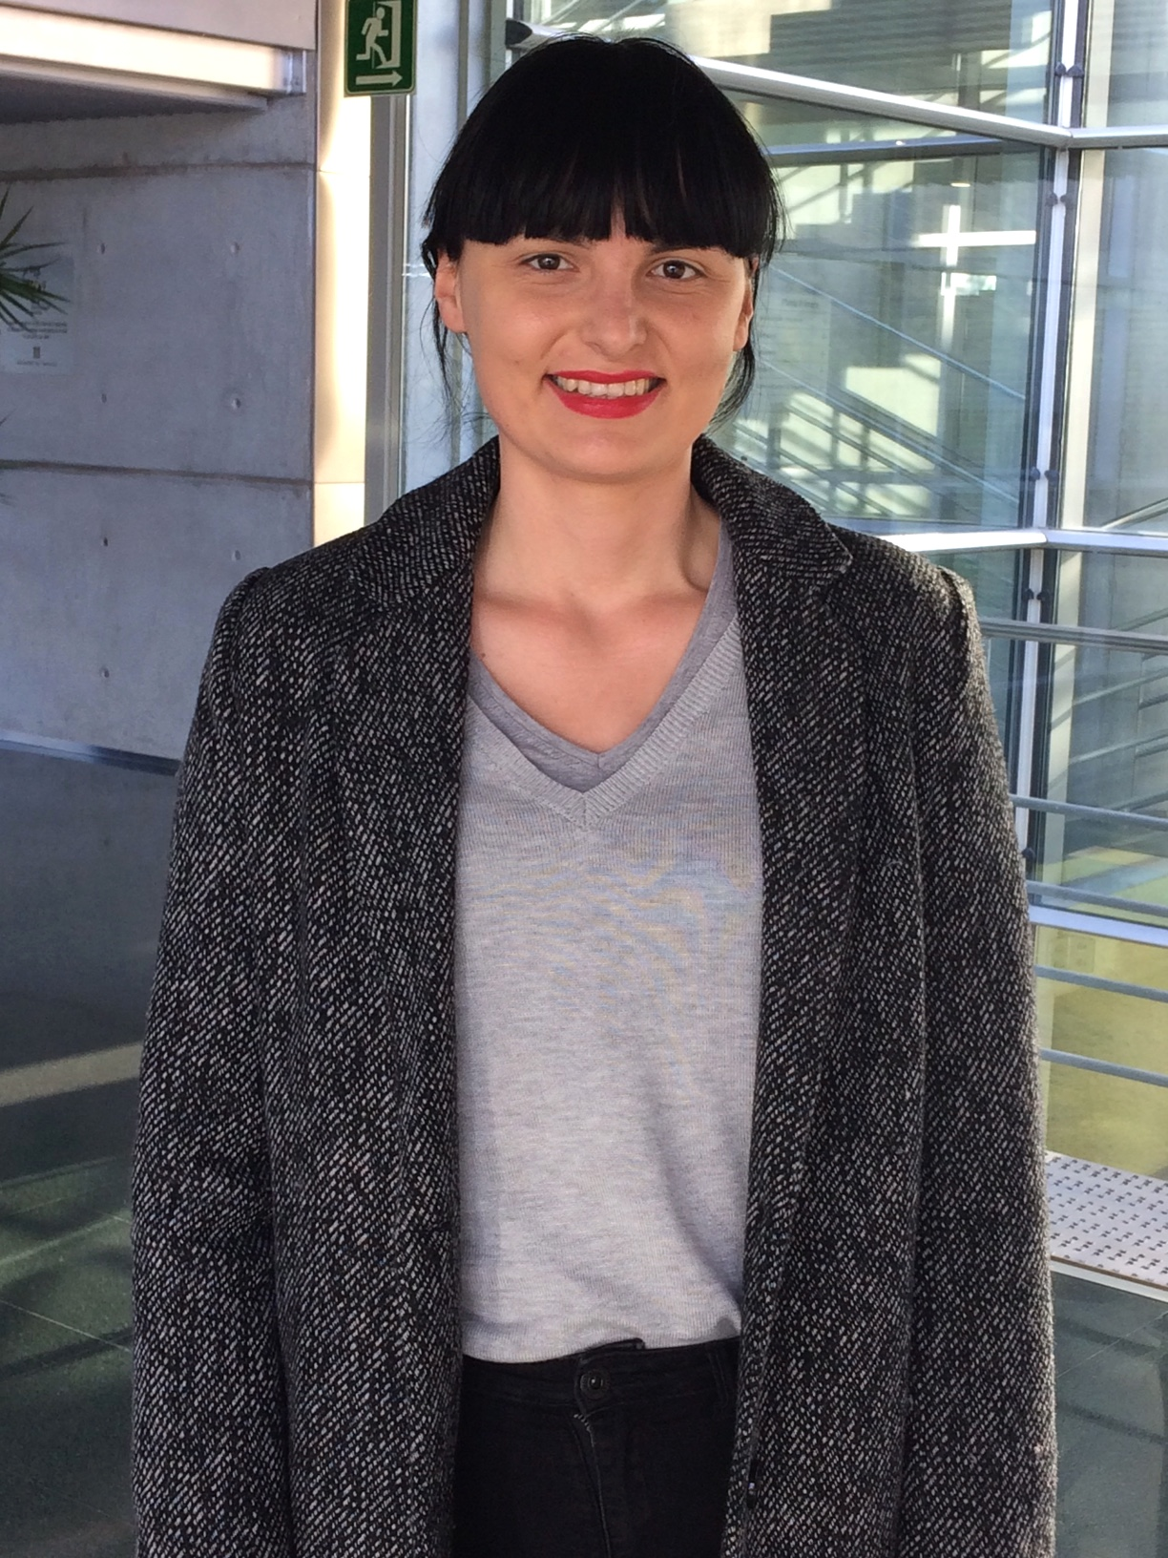
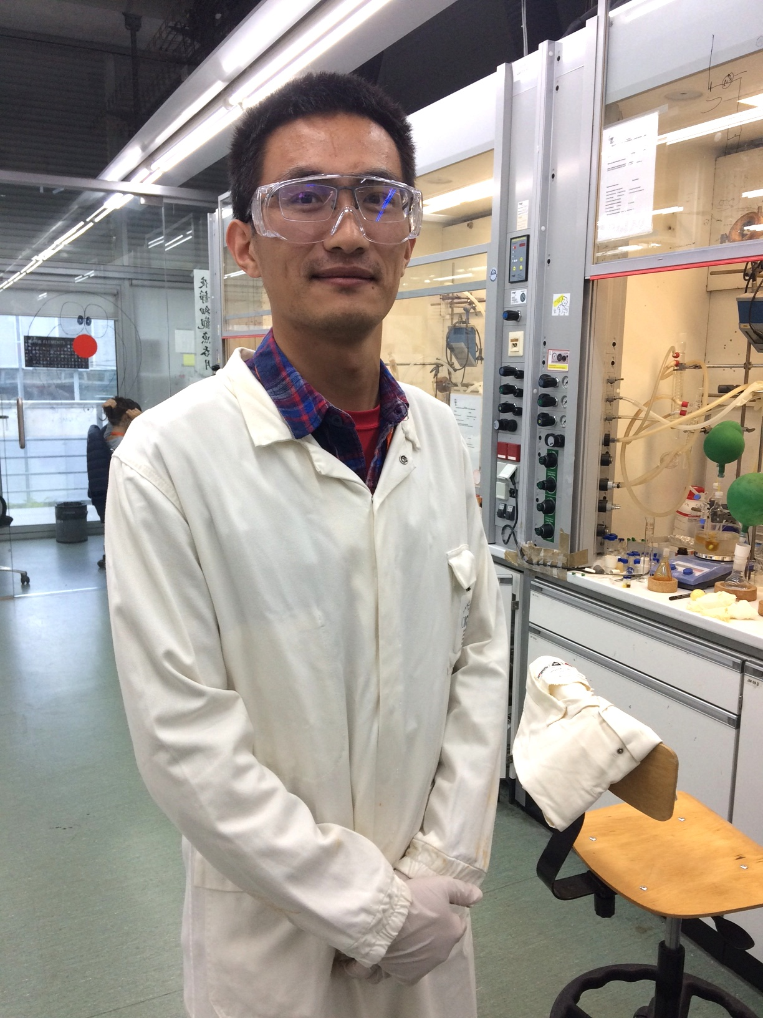
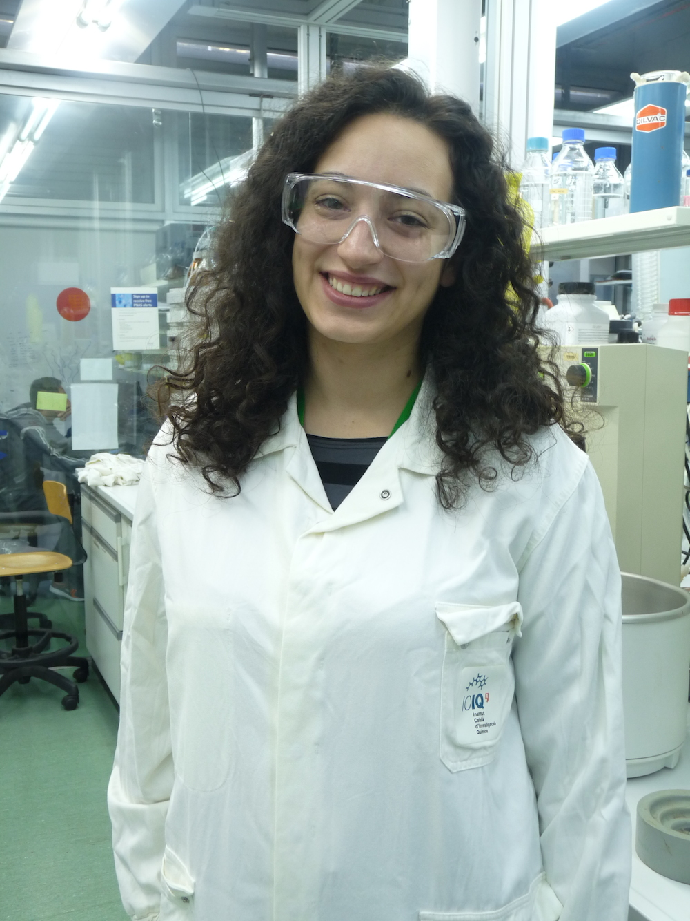
Who looks like a scientist?
Q2
Federico
Paulina
Giulia
Kun
Franziska

Slide 5

2008-2012, Italy
Humanities at the high school

Slide 6
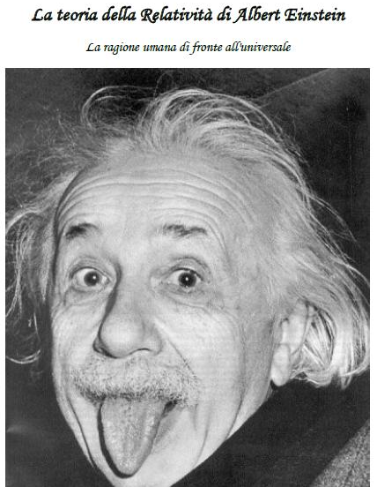
2012, High school thesis
The Theory of Relativity from
Albert Einstein
The human rational facing the universe
Quite an unexpected end!

Slide 7
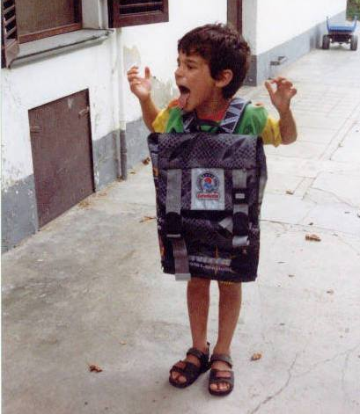
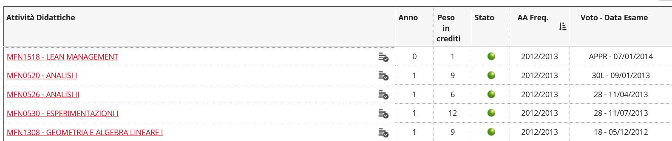
September 2012: Master in Physics!
Quite a terrible start!

Slide 8
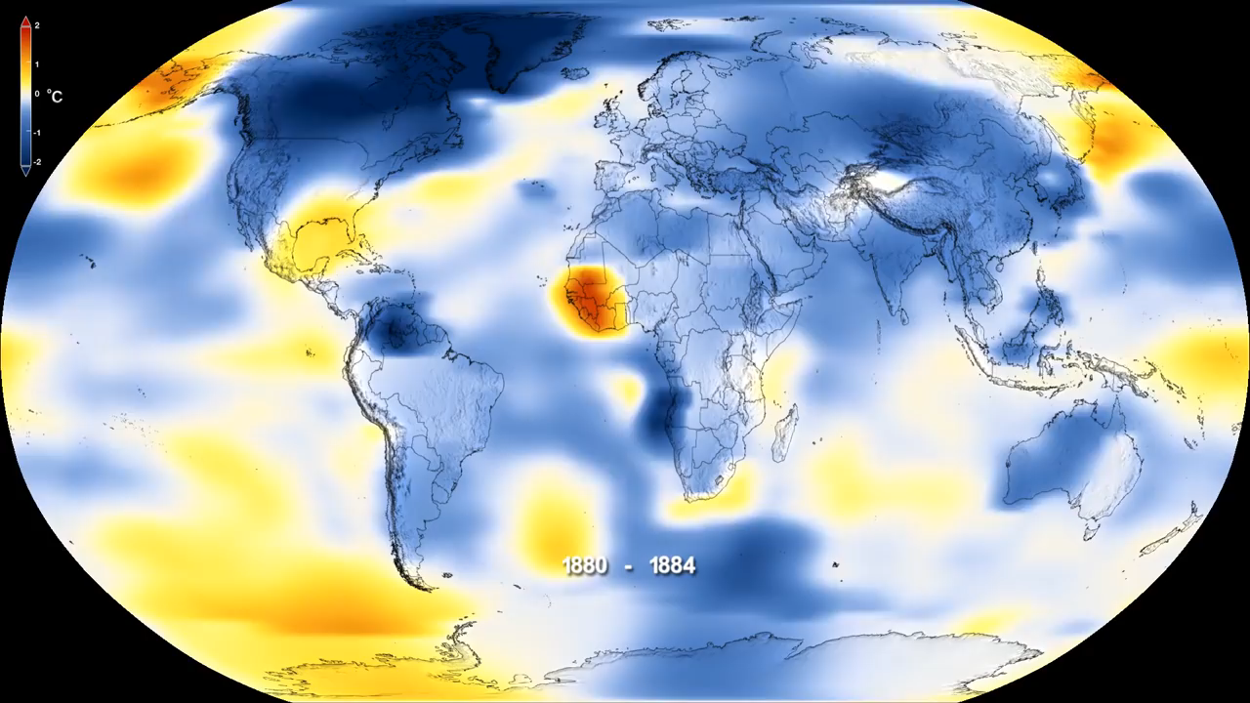
Climate change does not exist
NASA Climate Change: https://www.youtube.com/watch?v=gXXOkhoki8s

Slide 9
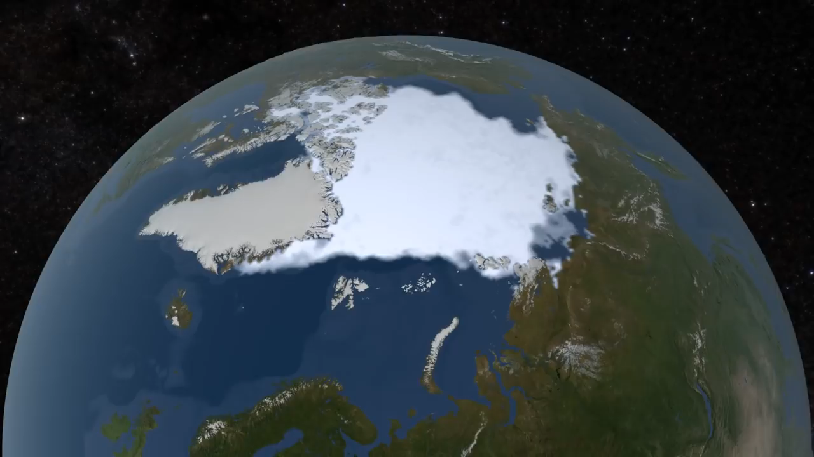
If you still have doubt…
NASA Climate Change: https://www.youtube.com/watch?v=Ymph_i6VWbM

Slide 10
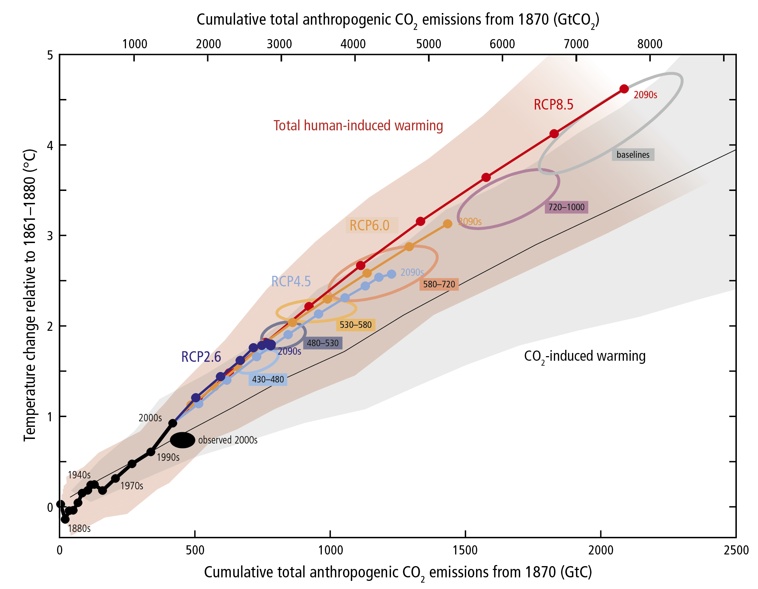
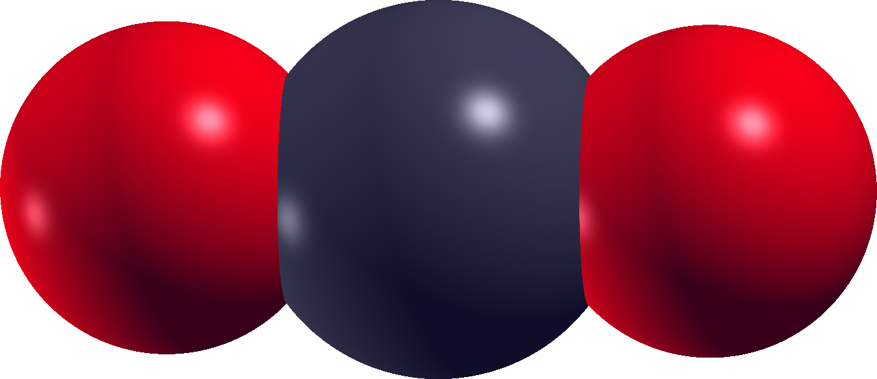
Why is CO₂ that important?

Slide 11
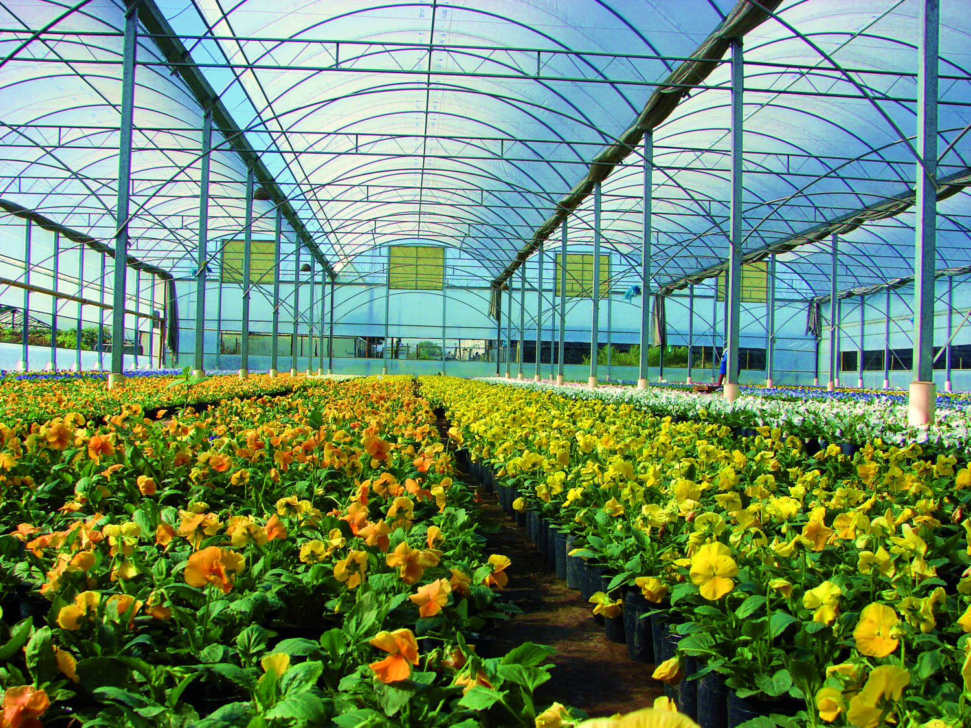
What is the greehouse effect?
Notes:
11

Slide 12
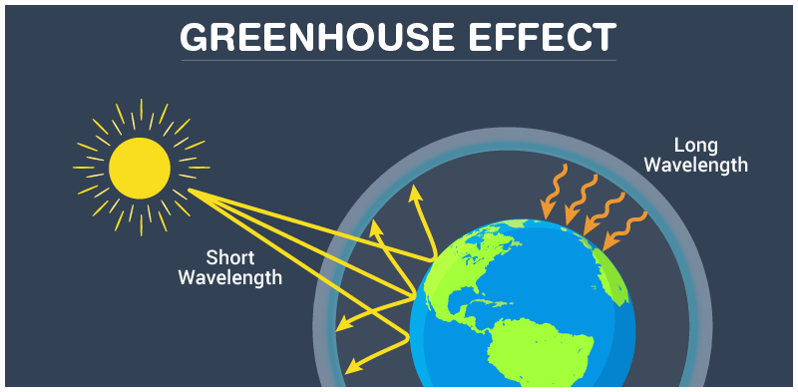
Notes:
12

Slide 13
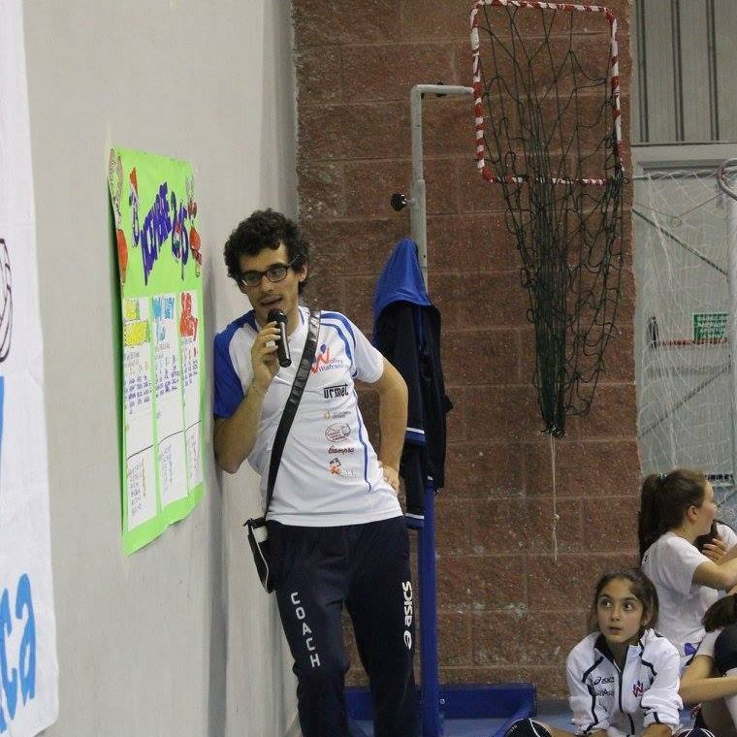
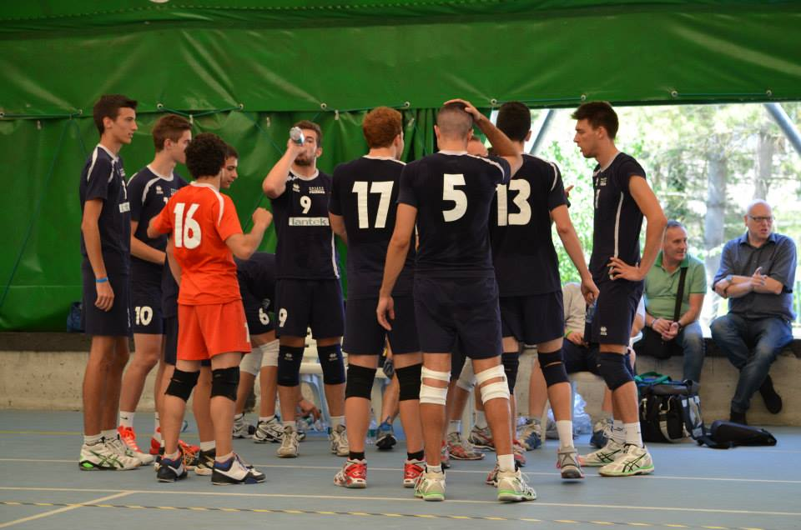
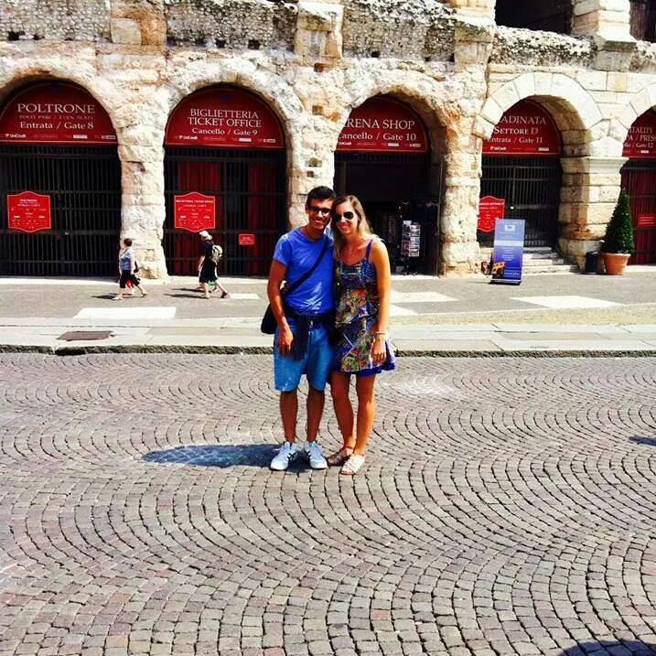
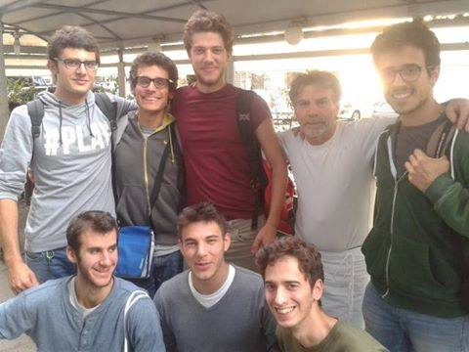
Just a teenager, so what’s next?

Slide 14
3rd year Bachelor in Physics…
What would you do?
Q3

Slide 15
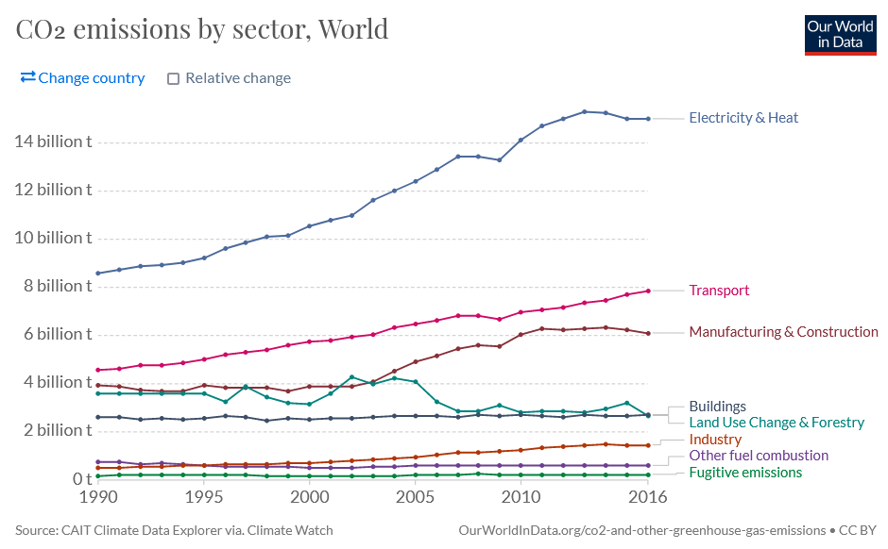
CO₂ emission by sector
https://ourworldindata.org/grapher/co-emissions-by-sector?country=~OWID_WRL

Slide 16

Do we need energy?
World energetic consumption
5 10²⁰ J in 2012
8 10²⁰ J in 2040
5 beers a day
50 years (20-70)
91250 ~ 1 10⁵ beers

Slide 17
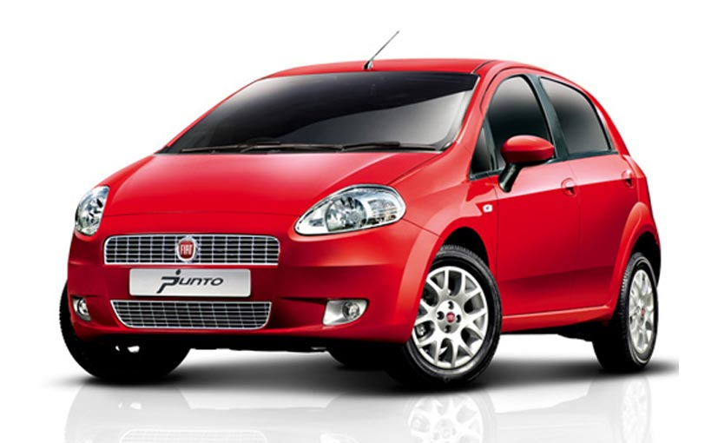
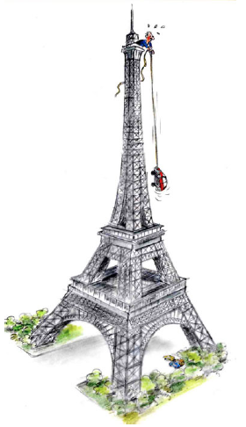
What is energy?
1 Wh = 3600 J
1 kWh (1000 Wh):
Pull a car on top of the Tour Eiffel (324 m)
Emission of 370 g of CO₂
(source ENDESA/MITECO)
Weekly absorption of a tree (source AQUAe Fundación)
Q4

Slide 18
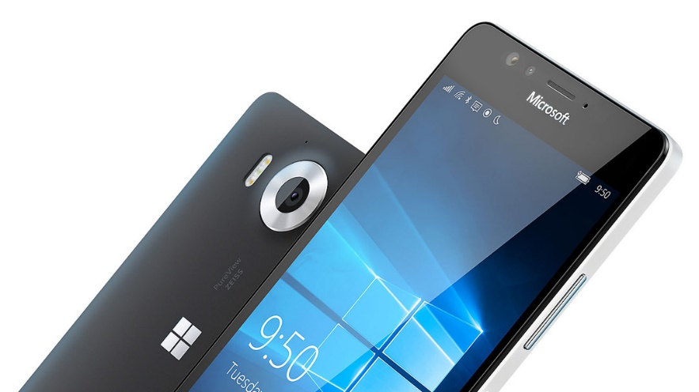
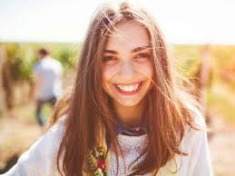
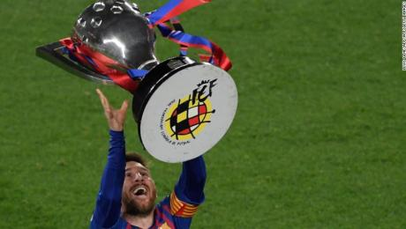
Mobile phone (11.6 W)
Annual consumption (16 hours per day) = 68 kWh
25 kg of CO₂
Teenager of 15/16 years: 2140-2700 kcal
(source FAO)
Daily consumption = 2.49-3.14 kWh
Annual consumption= 910-1150 kWh
Trip Tarragona-Camp Nou (source MITECO)
93 km
13.55 kg of CO₂ with gasolina engine
Weekly absorption of 37 trees

Slide 19
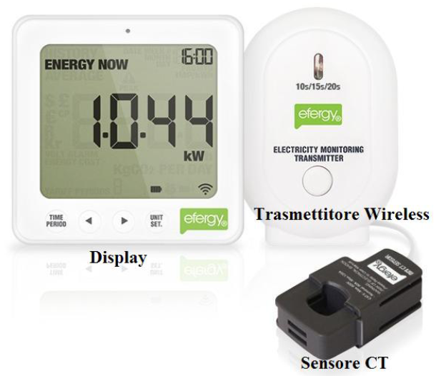
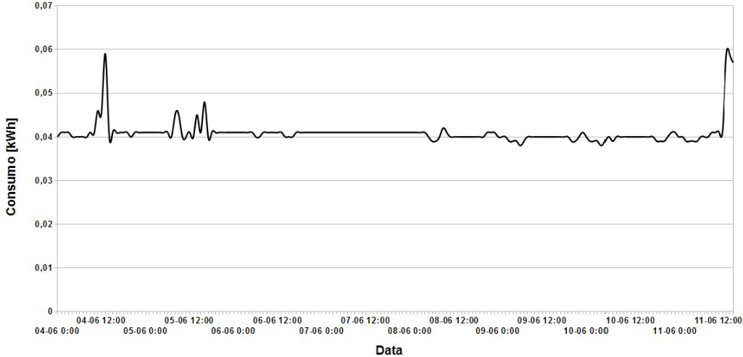
2015, Bachelor Thesis, Italy
We need to save energy!

Slide 20
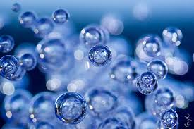

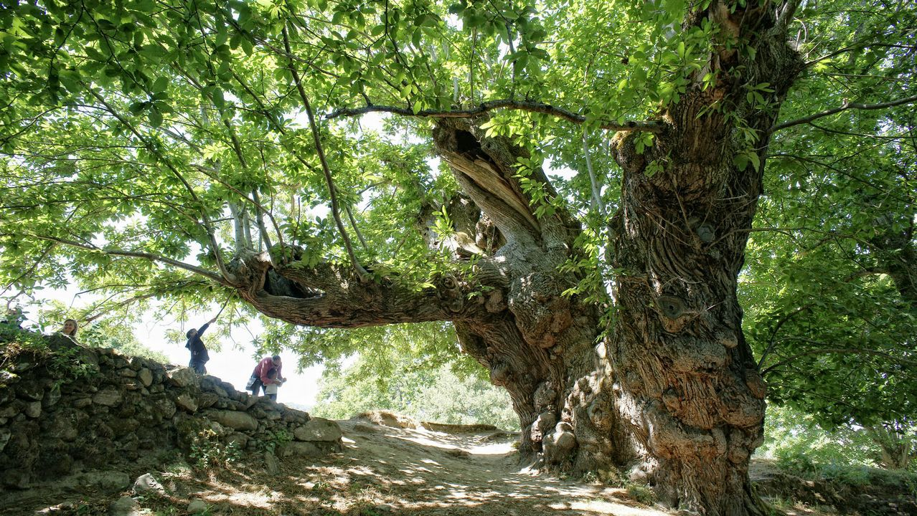
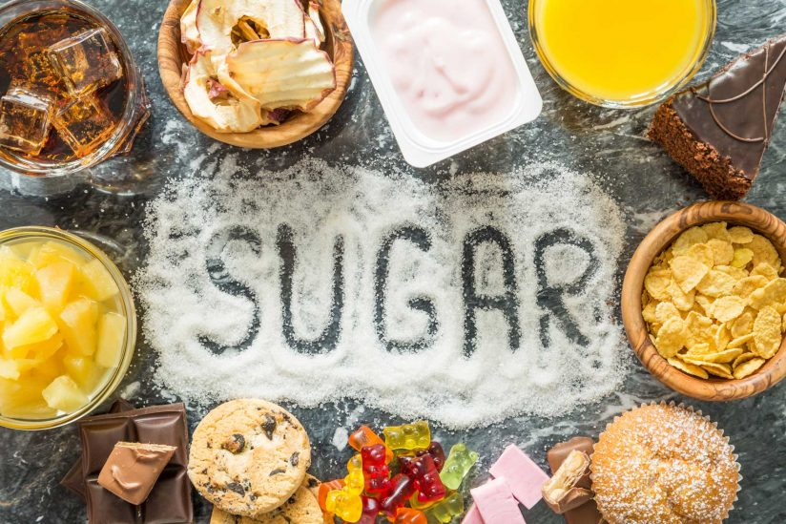

What about photosynthesis?
CO₂
O₂
Sunlight
Q5
1.3 kW/m²
Tree
Water
Energy storage
(sugars)

Slide 21
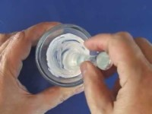
Dye-sensitized solar cells

Slide 22
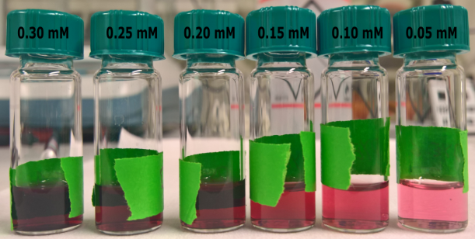
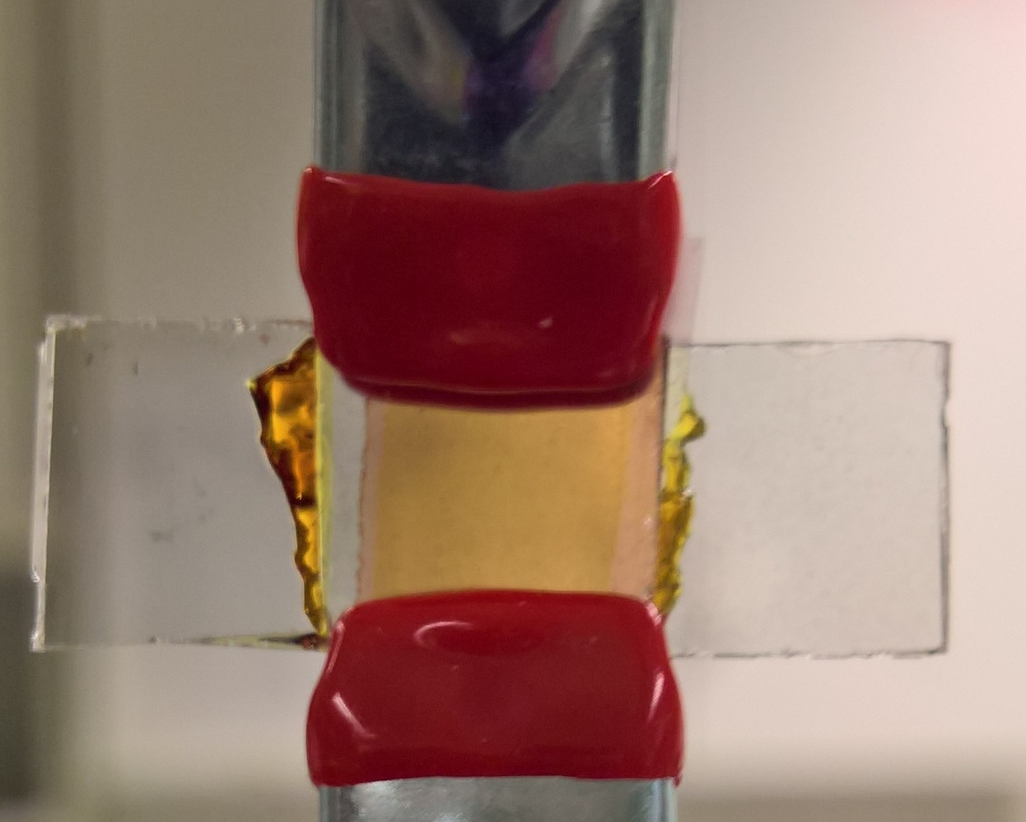
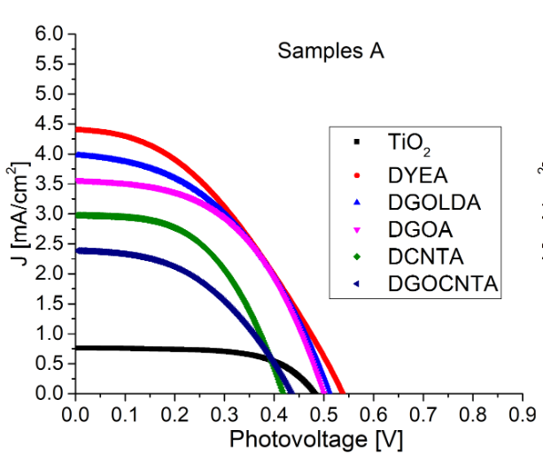
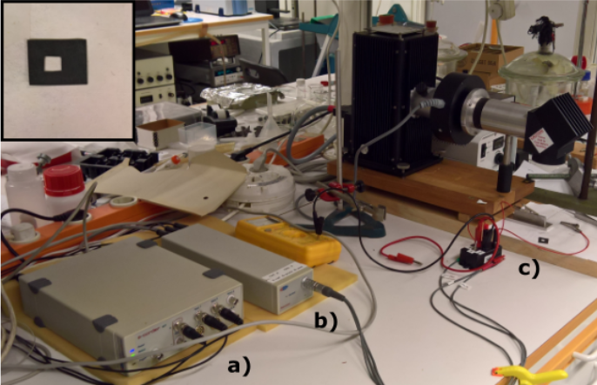
2017, Master Thesis, Sweden
Photoelectrochemistry is cooler!

Slide 23
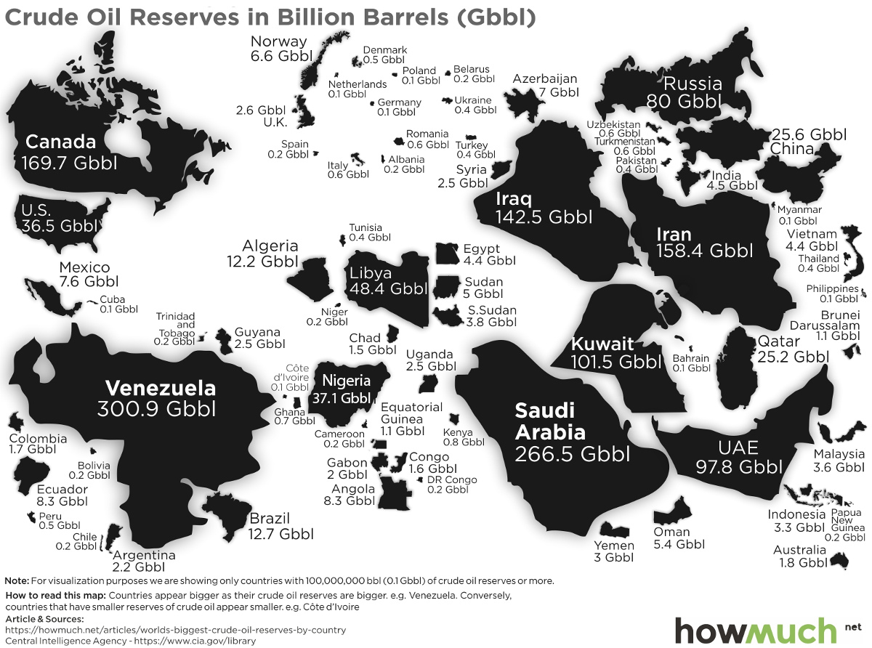
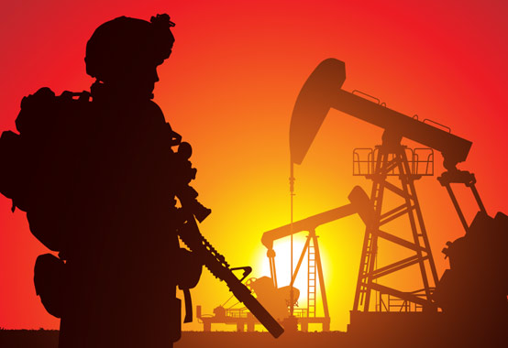
Organization of The Petroleum Exporting Countries (OPEC) https://www.visualcapitalist.com/

Slide 24
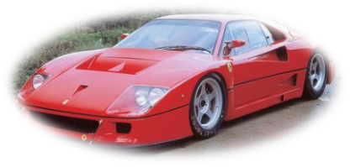
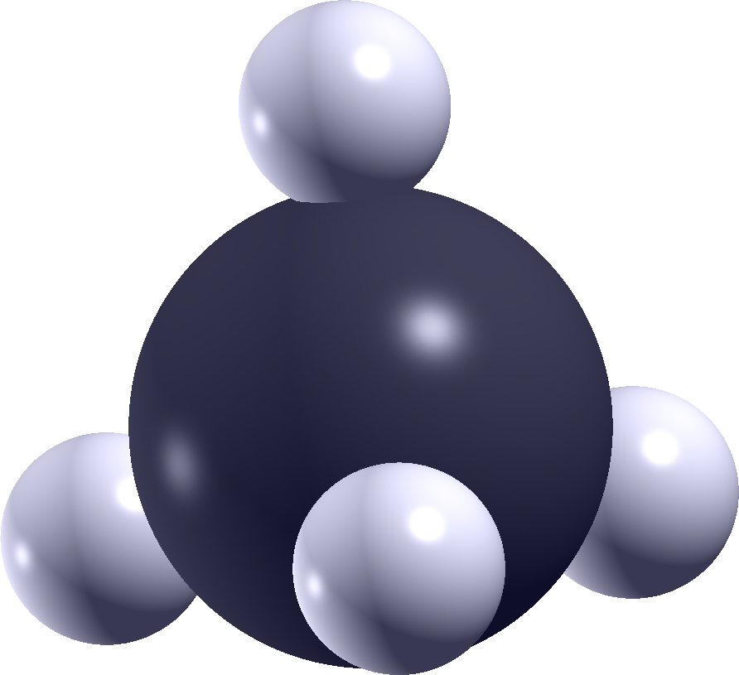
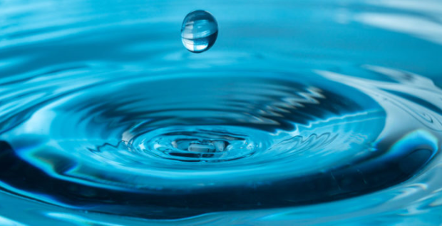
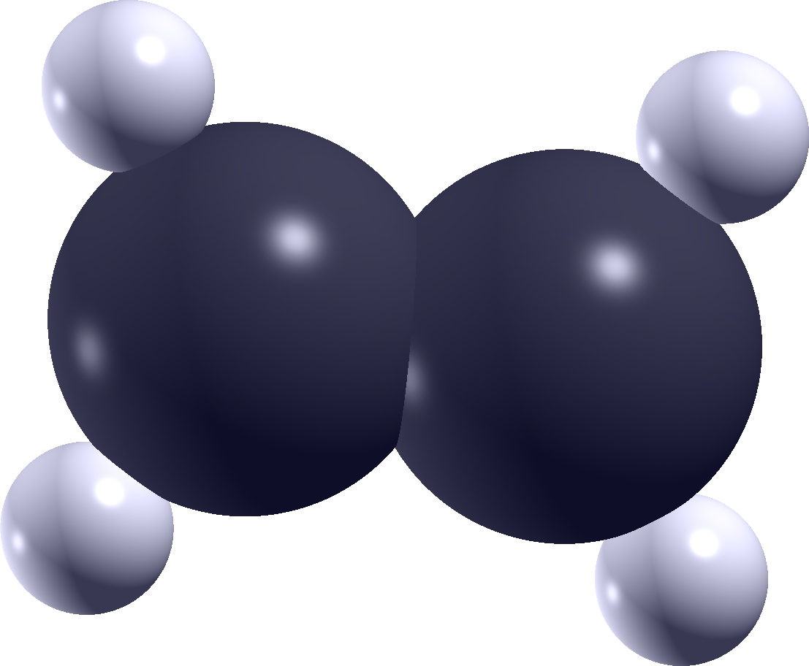
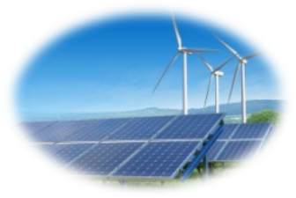
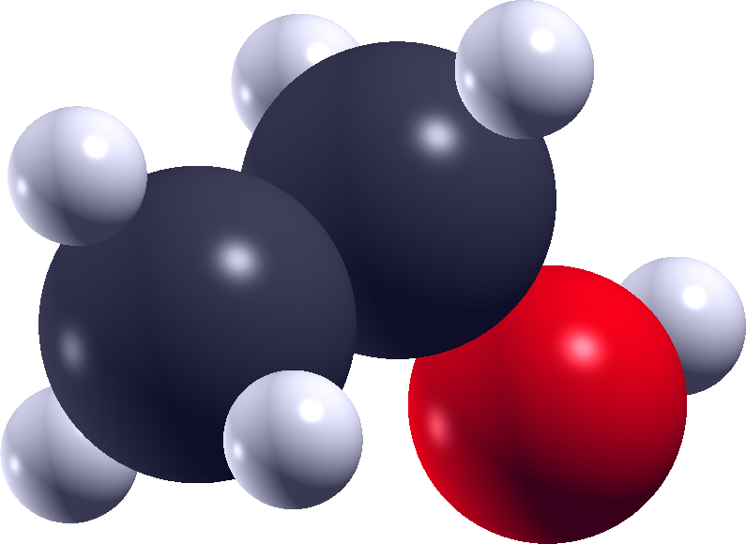
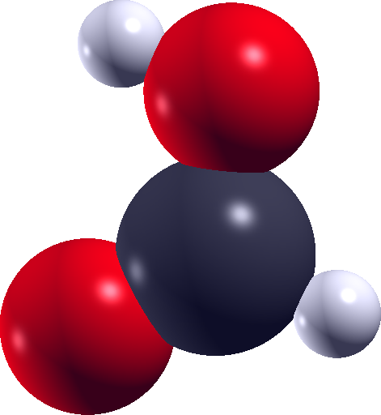
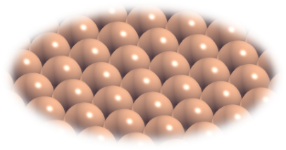
From carbon dioxide to energy storage?
Water
Renewable energy
Catalyst

Slide 25

An electrochemical cell

Slide 26

A closer look at the cathode

Slide 27

How does an electrochemical cell work?
Water Splitting: https://www.youtube.com/watch?v=HQ9Fhd7P_HA

Slide 28

Computational chemistry
Q6
How do you see a computational chemist?

Slide 29

Computational chemistry
How experimentalists see me…

Slide 30

Computational chemistry
How I see myself…

Slide 31

Computational chemistry
The harsh reality

Slide 32

Quick responses to imput…
How does the weather look like tomorrow?

Slide 33

...still, models must be accurate!

Slide 34






My beloved models

Slide 35


How “big” is a molecule?
10⁻⁵ m
10⁻¹⁰ m
100000 atoms in a single hair!
4 10⁸ m
1.75 m

Slide 36


Eventually, it’s all about love...
CO₂
always bad love stories

Slide 37

…between CO₂ and electrons...
CO₂
always bad love stories
Its beloved electron

Slide 38

…thank to a good friend...
CO₂
always bad love stories
Copper, a good friend
Its beloved electron

Slide 39



…O no, the third wheel!
CO₂
always bad love stories
Copper, a good friend
Its beloved electron
Hydrogen, the third wheel

Slide 40

…even worst!
CO₂
always bad love stories
Copper, an ****
Its beloved electron
Hydrogen, the third wheel

Slide 41

Which product would you select?
Q7
Chem 2018, 4, 2571–2586; Chem. Soc. Rev. 2014, 43, 631–675

Slide 42



From CO₂ to formate / formic acid

Slide 43



From CO₂ to CO
Hydrocarbons

Slide 44



From CO to ethylene

Slide 45





Slide 46







